Slide 1

In the name of Allah, most Gracious, most Compassionate

Slide 2



GOVERNING EQUATIONS OF SINGLE PARTICLE MODEL:
1. MASS CONSERVATION IN SOLID PHASE EQUATIONS:
$\frac{∂c_{sk}}{∂t}=\frac{1}{r^{2}}\frac{∂}{∂r}(r^{2}D_{sk}\frac{∂c_{sk}}{∂t})$, k=n,p.
(1)
B.C:
$${−D}_{sk}\frac{∂c_{sk}}{∂r}(r=R_{k},t)=j_{k}(x,t), {−D}_{sk}\frac{∂c_{sk}}{∂r}(r=0,t)=0 .$$
(2)
2. BUTLER-VOLMER EQUATIONS:
${j_{k}=2j_{k0}Sinh[\frac{F}{R_{g}T}(φ}_{sk}−U_{k})],$ k=n, p.
(3)
HERE
$${j_{k0}=k}_{k}(c_{smax,k}−c_{surk}){c_{surk}}^{0.5}, k=n,p.$$
(4)

Slide 3
VOLUME AVARAGE TECHNIQUE SOLUTION:
Fixed Parameters:
F := 96487, R := 8.3143.
Symbolic Parameters:
i, A, T, en, ep, Ln, Lp, kn, kp, Csp0, Csn0, Rp, Rn, Dsp, Dsn, cspmax, csnmax, Un, Up, t.
Specific Surface Area:
ap := 3*ep/Rp; an := 3*en/Rn;
Surface Concentration of Negative Electrode:
Csurn := (i, A, an, Ln, Csn0, Rn, Dsn, csnmax, t) ->
1/1350818000000000000*(1350818000000000000*Csn0*An*an*Ln*Rn*Dsn + 2400000000000*Rn^2*i*exp(-30*Dsn*t/Rn^2) - 42000000003087*i*t*Dsn - 2800000000000*Rn^2*i)/(A*an*Ln*Rn*Dsn); (5)
Surface Concentration of Positive Electrode:
Csurp := (i, A, ap, Lp, Csp0, Rp, Dsp, cspmax, t) -> 1/1350818000000000000*(1350818000000000000*Csp0*Ap*ap*Lp*Rp*Dsp - 2400000000000*Rp^2*i*exp(-30*Dsp*t/Rp^2) + 42000000003087*i*t*Dsp + 2800000000000*Rp^2*i)/(A*ap*Lp*Rp*Dsp); (6)

Slide 4
VOLUME AVARAGE TECHNIQUE SOLUTION:
OCP for Negative Electrode:
xn := Csurn/csnmax; (7)
U_n:= (xn)-> (8)
OCP for Postive Electrode:
yn:=Csurp/cspmax; (9)
U_p:=(y)-> (10)

Slide 5
VOLUME AVARAGE TECHNIQUE SOLUTION:
Terminal Voltage:
V := (i, A, T, an, ap, Ln, Lp, kn, kp, Csp0, Csn0, Rp, Rn, Dsp, Dsn, cspmax, csnmax, Un, Up, t) -> Up + (-1)*0.0001723403153*T*arcsinh(7000000000000*i*sqrt(1350818)/(ap*Ap*Lp*kp*sqrt((1350818000000000000*Csp0*Ap*ap*Lp*Rp*Dsp - 2400000000000*Rp^2*i*exp(-30*Dsp*t/Rp^2) + 42000000003087*i*t*Dsp + 2800000000000*Rp^2*i)/(A*ap*Lp*Rp*Dsp))*sqrt(1824709269124000000000000*cspmax - (1824709269124000000000000*Csp0*Ap*ap*Lp*Rp*Dsp - 3241963200000000000*Rp^2*i*exp(-30*Dsp*t/Rp^2) + 56734356004169975166*i*t*Dsp + 3782290400000000000*Rp^2*i)/(A*ap*Lp*Rp*Dsp)))) - Un + (-1)*0.0001723403153*T*arcsinh(7000000000000*i*sqrt(1350818)/(An*an*Ln*kn*sqrt((1350818000000000000*Csn0*An*an*Ln*Rn*Dsn + 2400000000000*Rn^2*i*exp(-30*Dsn*t/Rn^2) - 42000000003087*i*t*Dsn - 2800000000000*Rn^2*i)/(Aan*Ln*Rn*Dsn))*sqrt(1824709269124000000000000*csnmax - (1824709269124000000000000*Csn0*An*an*Ln*Rn*Dsn + 3241963200000000000*Rn^2*i*exp(-30*Dsn*t/Rn^2) - 56734356004169975166*i*t*Dsn - 3782290400000000000*Rn^2*i)/(A*an*Ln*Rn*Dsn))));
(11)

Slide 6
VOLUME AVARAGE TECHNIQUE SOLUTION:
Values of Parameters:
T := 298.15; Ln := 10.*10^(-5); Lp := 10.*10^(-5); csnmax := 31330; cspmax := 51000;
Csp0 := 0.25 . cspmax; Csn0 := 0.99*csnmax; Rn := 11*10^(-6); Rp := 11*10^(-6);
en := 0.6; ep := 0.5; ap := 3*ep/Rp; an := 3*en/Rn;
Dsp := 10*10^(-14); Dsn := 3.9*10^(-14);
kn := 20*10^(-11); kp := 20*10^(-11);
A := 1;
i := 50*C_rate;
Negative Electrode OCP(Graphite):
U_n:= (xn)->0.6379 + 0.5416*exp(-305.5309*xn) + 0.044*tanh(-(xn - 0.1958)/0.1088) - 0.1978*tanh((xn - 1.0578)/0.0854) - 0.6875*tanh((xn + 0.0117)/0.0529) - 0.0175*tanh((xn - 0.5692)/0.0875;
Positive Electrode OCP (NMC622):
U_p:=(y)->(-5.057 - 13.6*y^2 + 121.6*y^4 - 185.1*y^6 - 45.43*y^8 + 127.7*y^10)/(-1 - 5.04*y^2 + 32.3*y^4 - 40.95*y^6 - 25.94*y^8 + 40.63*y^10);

Slide 7
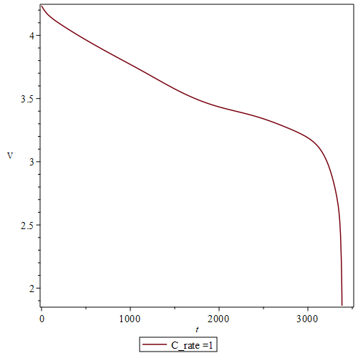
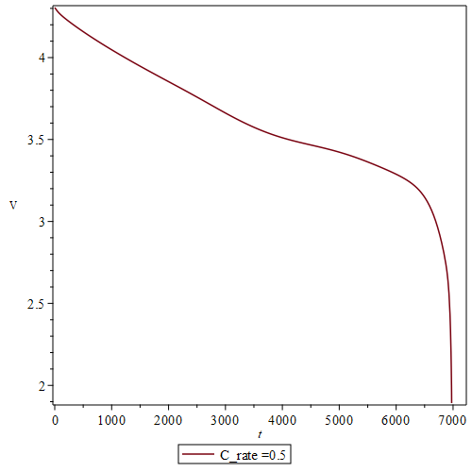
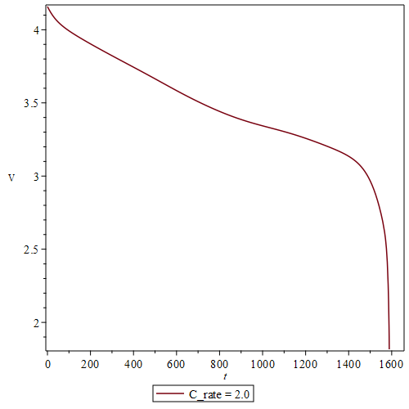
VOLUME AVARAGE TECHNIQUE SOLUTION:
Figures 1-3:Discharge Curves for C_rates = 0.5, 1 , 2.

Slide 8
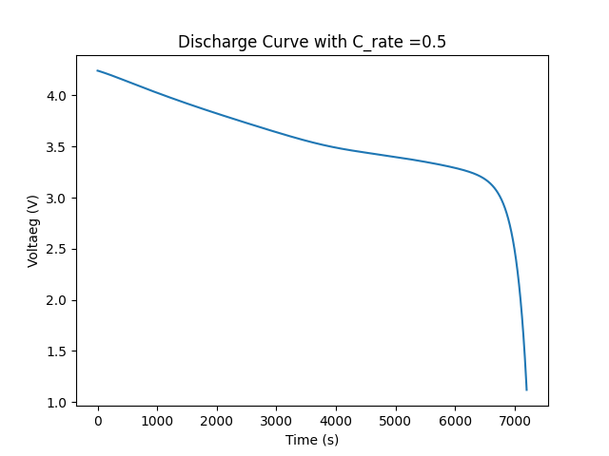
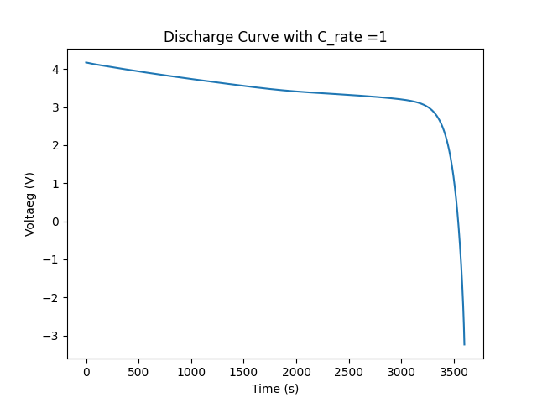
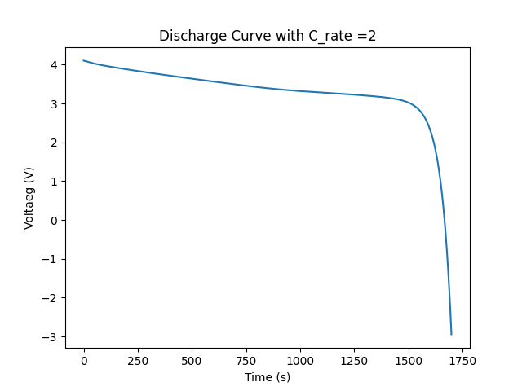
VOLUME AVARAGE TECHNIQUE SOLUTION:
Figures 4-6:Discharge Curves for C_rates = 0.5, 1 , 2.

Slide 9
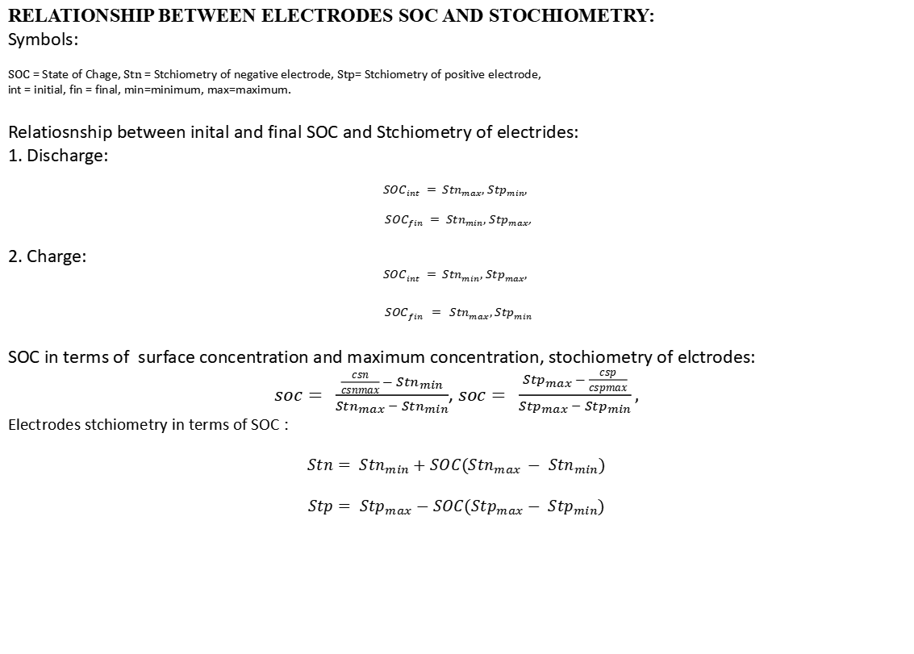
RELATIONSHIP BETWEEN ELECTRODES SOC AND STOCHIOMETRY:
Symbols:
$SOC$ = State of Chage, $Stn$ = Stchiometry of negative electrode, $Stp$= Stchiometry of positive electrode,
int = initial, fin = final, min=minimum, max=maximum.
Relatiosnship between inital and final SOC and Stchiometry of electrides:
1. Discharge:
$${SOC}_{int} = {Stn}_{max}, {Stp}_{min},$$
${SOC}_{fin} = {Stn}_{min}, {Stp}_{max}$,
2. Charge:
$${SOC}_{int} = {Stn}_{min}, {Stp}_{max},$$
$${SOC}_{fin} = {Stn}_{max}, {Stp}_{min}$$
SOC in terms of surface concentration and maximum concentration, stochiometry of elctrodes:
$soc= \frac{\frac{csn}{csnmax} −{ Stn}_{min}}{{{Stn}_{max}− Stn}_{min}}$, $soc= \frac{{Stp}_{max} − \frac{csp}{cspmax}}{{{Stp}_{max}− Stp}_{min}},$
Electrodes stchiometry in terms of SOC :
$$Stn={ Stn}_{min}+SOC({{Stn}_{max }− Stn}_{min})$$
$$Stp={ Stp}_{max}−SOC({{Stp}_{max}− Stp}_{min})$$

Slide 10

RELATIONSHIP BETWEEN ELECTRODES SOC AND STOCHIOMETRY:
Electrodes stchiometry in terms of SOC (for any inital and final SOC):
$$Stn={ Stn}_{min}+SOC({{Stn}_{max }− Stn}_{min})$$
$$Stp={ Stp}_{max}−SOC({{Stp}_{max}− Stp}_{min})$$

Slide 11


